Slide 1
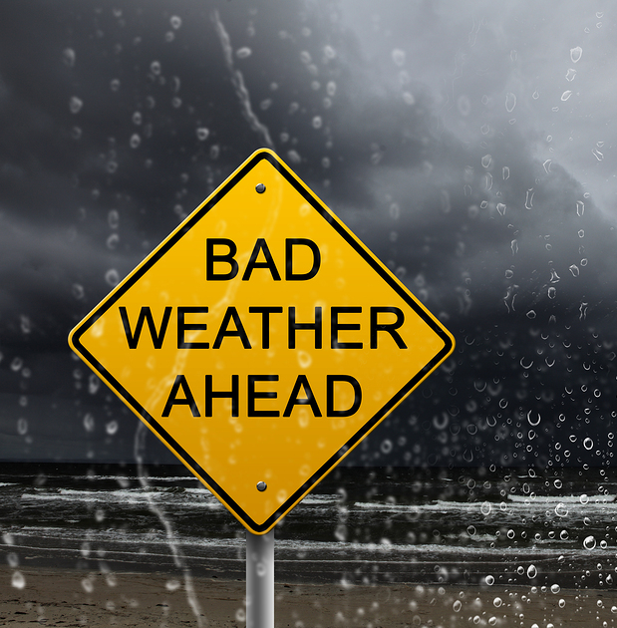
Prediction of Network Deterioration using ML Prediction Algorithm
Boppana Rhea Ramanamurthy(20BCE7389)
Rithy Raichel Soj(20BCN7026)
Twinkle Kumari(20BCN7023)
This Photo by Unknown author is licensed under CC BY-ND.

Slide 2
Motivation
The motivation behind this project is:
to predict network degradation
to enhance network reliability
improve user experience
gain data-driven insights
foster learning and innovation
By predicting network deterioration using machine learning, organizations can :
ensure reliable network performance
minimize disruptions
make informed decisions for network optimization and expansion.

Slide 3
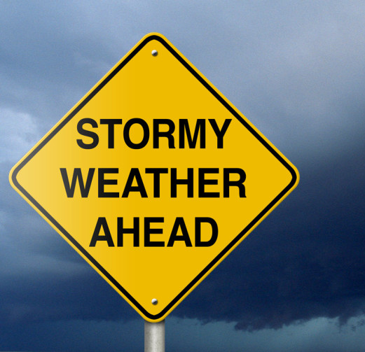


Objectives
Identify relevant network indicators.
Build effective deterioration prediction models using machine learning algorithms and weather datasets.
Develop an early warning system for timely interventions.
This Photo by Unknown author is licensed under CC BY-NC.

Slide 4
Hypothesis
It is possible to anticipate network deterioration with a high degree of accuracy by examining past network data availability during severe weather conditions and utilizing machine learning methods. The created predictive model will find patterns and trends in network performance parameters, enabling preventive maintenance and reducing downtime. Ultimately, this strategy will increase network dependability and raise user satisfaction levels.

Slide 5

Problem Survey
A thorough investigation to comprehend current network deterioration detection techniques, a look at the possibility of machine learning, and a review of relevant studies to address issues with predictive maintenance.

Slide 6
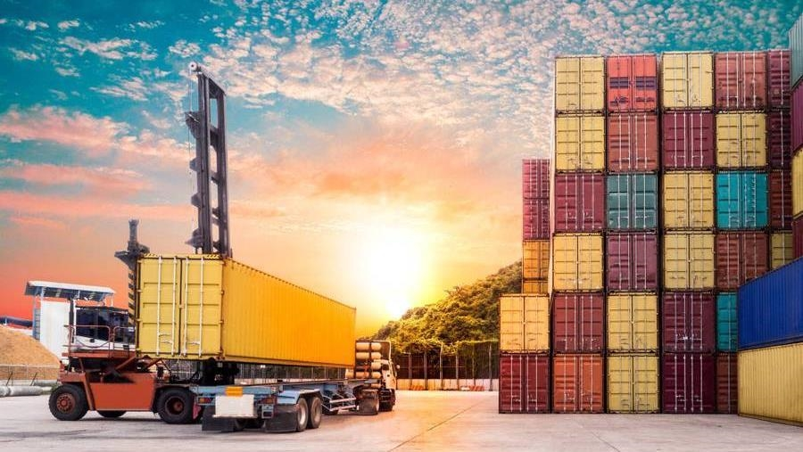
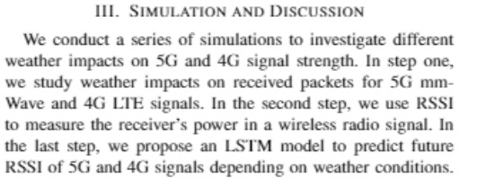
Topic DISCUSSION
Base Paper:
Investigation of 5G and 4G V2V Communication Channel Performance Under Severe Weather (October 2022 IEEE International Conference on Wireless for Space and Extreme Environments (WiSEE)

Slide 7
Following the methodology provided by the authors in the base paper, we will be able to accomplish obtaining the prediction algorithm, with the weather parameters used as input remaining mostly the same. However, since the application of the method differs from the authors, we will be expanding the scope of the research by attempting to implement the prediction algorithm for open space communication, during severe weather conditions.
Requirements:
Recent and accurate weather datasets (provided by IMD Data Supply Unit)
Jupyter Notebook
Network Simulation Tool (NS3)
MATLAB channel model

Slide 8

Summary
Gathering information prior to an impending severe weather condition would guarantee a prepared network , at occurrence. The ML prediction algorithm will alert the network administrators and provide them enough time to consider an alternate packet transfer route, or implement policies to allow only necessary traffic so as to provide better performance to keep important resources and services running.

Slide 9

Timeline
Dataset
Obtain accurate weather datasets, directly from the IMD using the Data Supply initiative provided for students upon submitting the undertaking signed by the Head of Department.
Code the ML algorithm
Decided approach mentioned in the previous slide will be followed, and the ML algorithm will be coded accordingly. Cloud services need to be discussed.
Train the model
Upon achieving an error-free code, we train it on 80% of available data.
Send alerts to the mobile application
Upon predicting future weather conditions, based on trained data, the prediction of network degradation will be sent as an alert to the user's device, providing the predicted date.
Test the model
The device for the training and consecutive testing (20% of available data) needs to discussed. Weather API will be used to get inputs for future 3 consecutive days for prediction.

Slide 10



THANK YOU

